Slide 1


London
IBM Applied Data Science Capstone
Jesus Ransanz jaransanz@gmail.com
The battle of Neigbourghoods

Slide 2
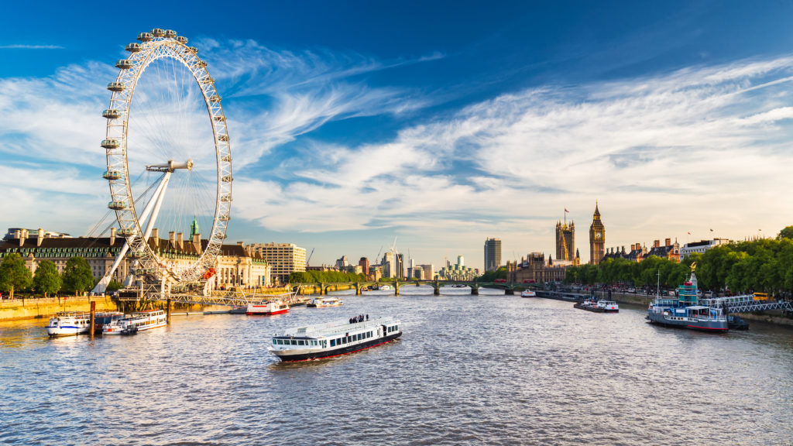
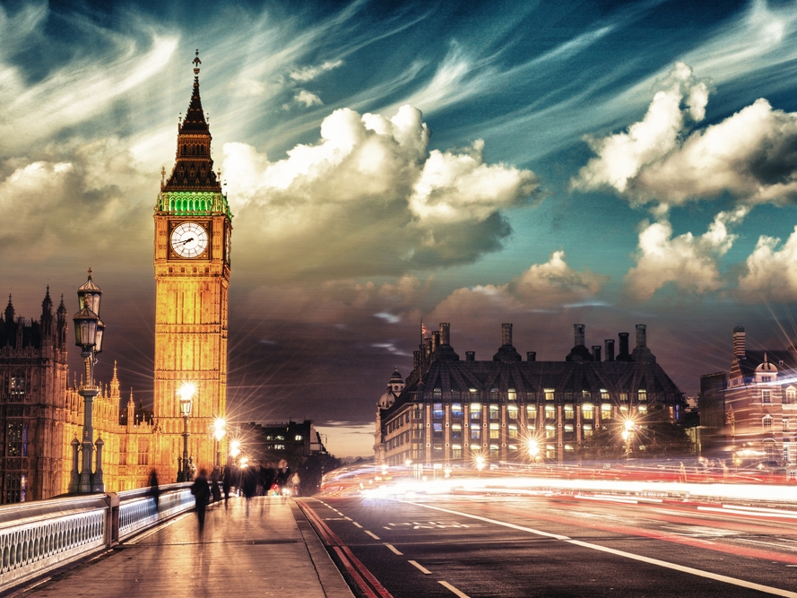
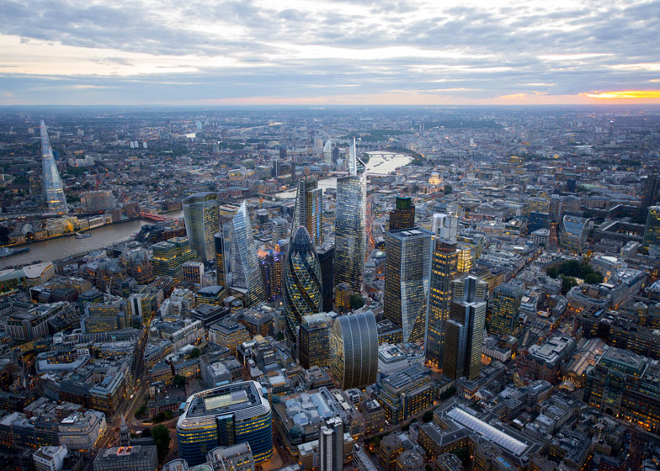
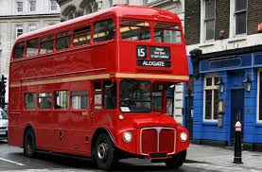
Imagine that you have to move to London:
Over 6 million people live in 33 boroughs.
Which areas are similar to live in ?

Slide 3

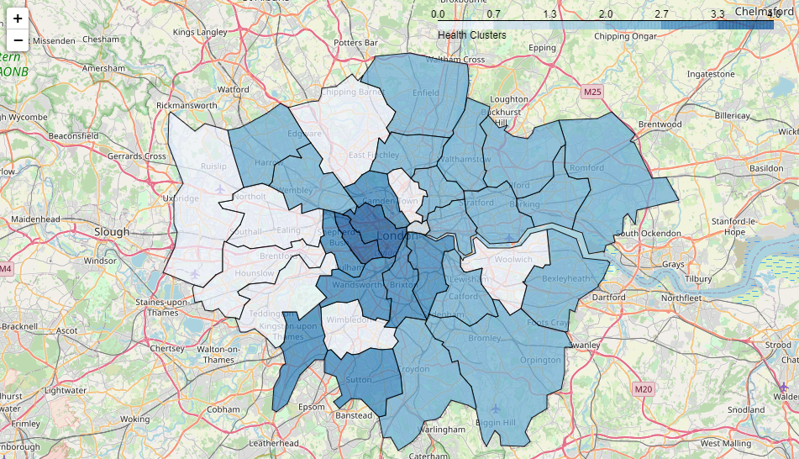
Areas with similar access to health venues

Slide 4

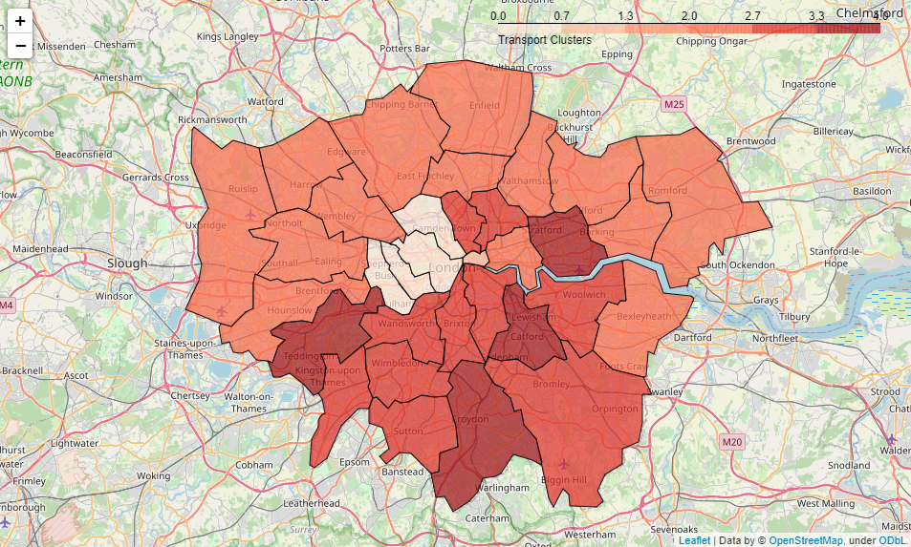
Areas with similar access to Transport

Slide 5

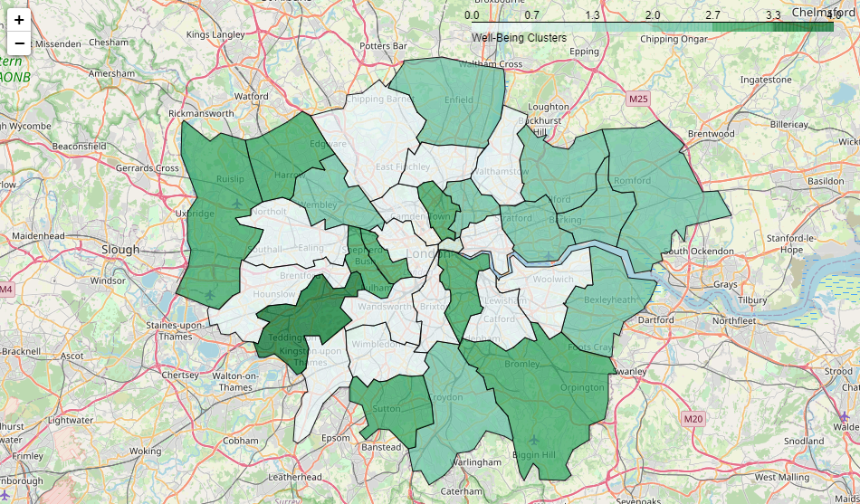
Areas with similar access to Well Being Venues

Slide 6

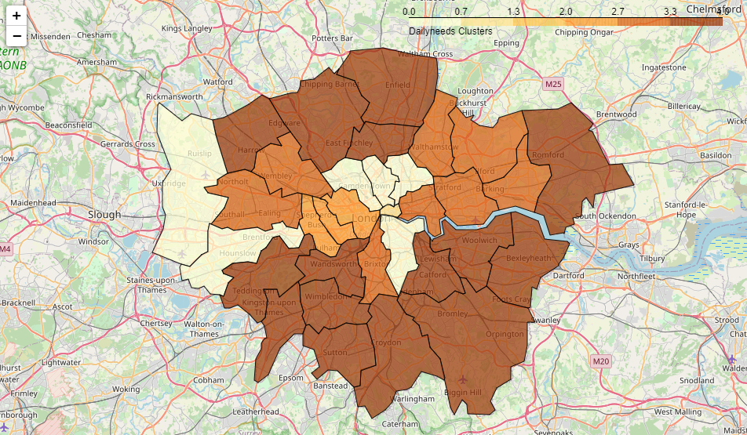
Areas with similar access daily needs venues

Slide 7

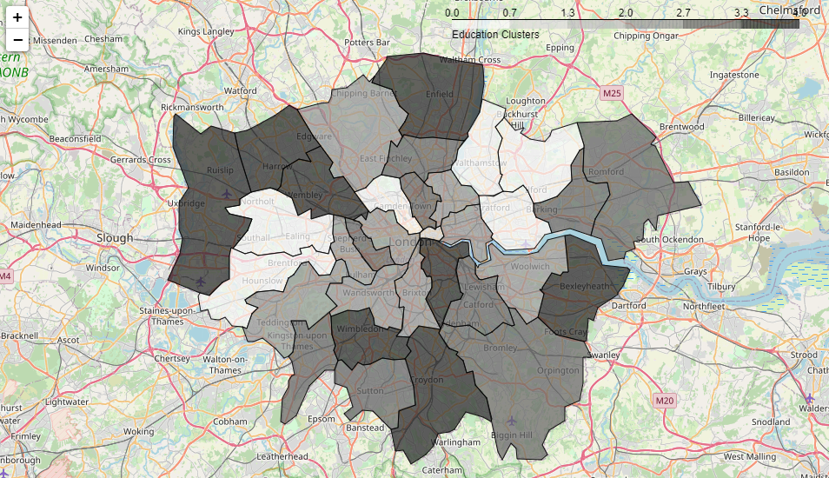
Areas with similar access to Education Venues

Slide 8
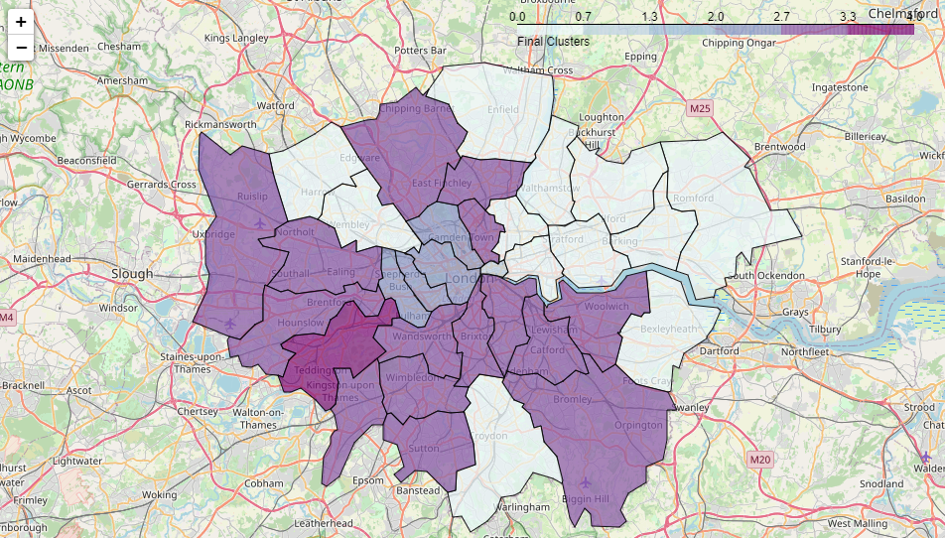
Conclusion
2 Centre Area
In the average but with excellent acces to Transport and Health
1 City of London Highest ratios -
0 North
Below the average in almost all ratios
3 South
Average
4 Richmond upon Thames Well above the average

